Slide 1
IBM ENGAGEMENT
PROJECT SUBMISSION
EXPLORING THE POWER OF MACHINE LEARNING WITH IBM CLOUD

Slide 2
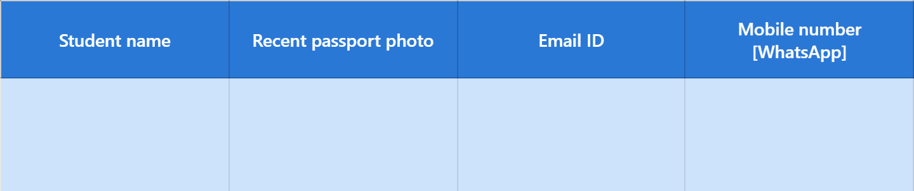

PROJECT TITLE: ESTATE IQ
DOMAIN OF THE PROJECT: Real Estate
NETRA K
netrakrishnakumar2007@gmail.com
8754182108

Slide 3
PROBLEM STATEMENT
The real estate sector is one of the largest contributors to economic growth, yet property pricing remains inconsistent and often lacks transparency.
Many families, especially first-time home buyers and middle-income households, struggle to determine whether a property's price is fair.
Dependence on manual valuation, local brokers, and subjective opinions can lead to overpricing, underpricing, financial loss, and reduced trust in the housing market.
Property valuation is influenced by multiple factors such as area, location, number of bedrooms, bathrooms, property condition, year built, and garage availability, making accurate estimation complex.
There is a growing need for an AI-powered, data-driven solution that delivers reliable property valuations within seconds.
EstateIQ aims to democratize real estate pricing by providing accurate, transparent, and instant house price predictions, empowering buyers, sellers, and investors to make informed financial decisions.

Slide 4
PROPOSED SOLUTION
Develop estateiq, an intelligent house price prediction platform powered by ibm watsonx.Ai studio autoai.
Collect essential property features including area, location, bedrooms, bathrooms, condition, year built, floors, and garage availability through a simple web interface.
Utilize IBM AutoAI to automate data preprocessing, feature engineering, algorithm selection, model training, and hyperparameter optimization.
Deploy the best-performing regression model and integrate it with a Flask-based web application for real-time predictions.
Generate instant, data-driven house price estimates, reducing dependence on manual valuation and subjective judgments.
Promote fairness, transparency, and accessibility in property valuation, enabling buyers, sellers, investors, and financial institutions to make confident decisions.
Create a scalable solution that can be enhanced in the future with real-time market trends, GIS-based location intelligence, and property recommendation features.

Slide 5
TECHNOLOGY USED
IBM Cloud – It provides the infrastructure to build, deploy, and scale EstateIQ efficiently. IBM Cloud offers a secure, reliable, and scalable environment for deploying the AI-powered House Price Prediction System, enabling real-time property valuation and seamless user access.
ML Algorithm / Model Used: Ridge Regression (Selected by IBM watsonx.ai AutoAI)
Accuracy Obtained: 90% Model performance evaluated using R² Score, RMSE, and MAE (Regression Metrics).
Enhancements and Hyperparameter Tuning: Automatically performed by IBM watsonx.ai AutoAI through intelligent data preprocessing, feature engineering, cross-validation, algorithm selection, and hyperparameter optimization to improve prediction performance.
Frontend Technologies: HTML5, CSS3, Bootstrap 5, JavaScript for a responsive and user-friendly interface.
Backend Technology: Python Flask for integrating the trained AI model with the web application and enabling real-time predictions.
Deployment: IBM Cloud Deployment Space for secure online model deployment and inference.

Slide 6
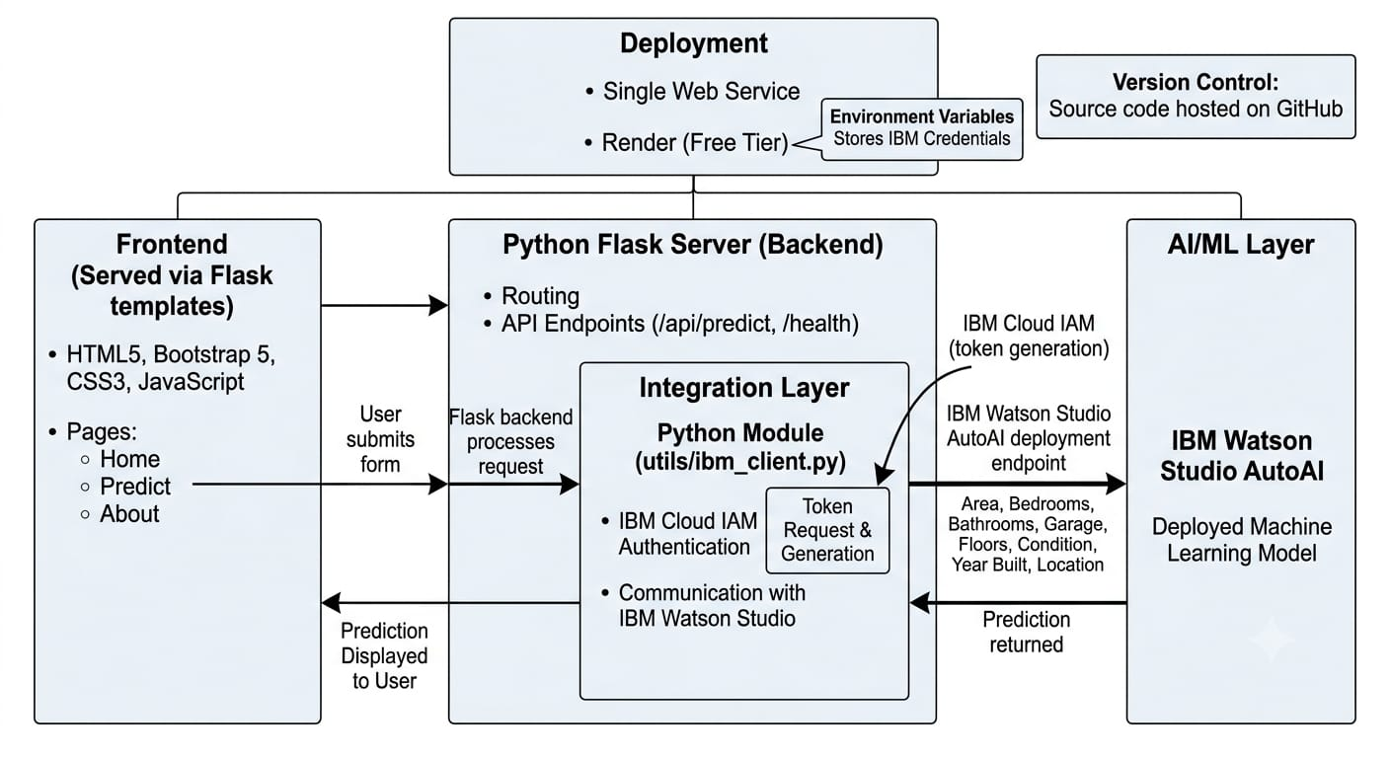
SYSTEM ARCHITECTURE

Slide 7
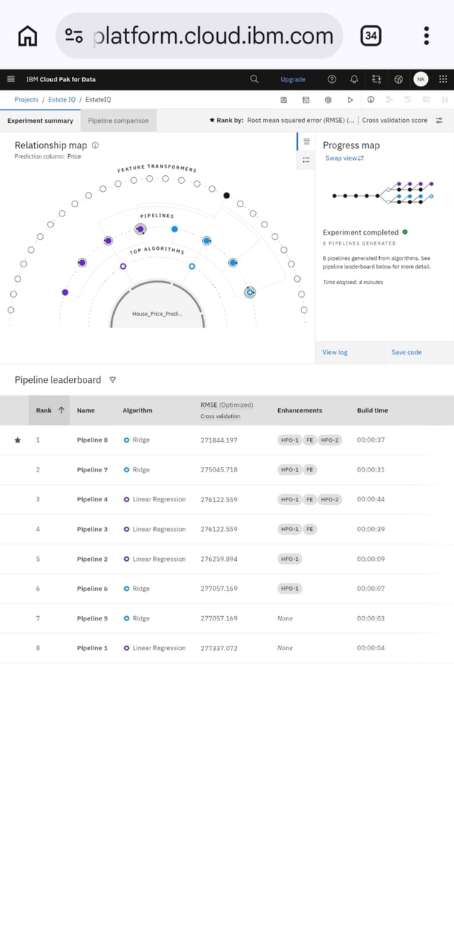
TRAINING SCREENSHOT
Prediction Result $418,320 Estimated property value based on AI analysis

Slide 8
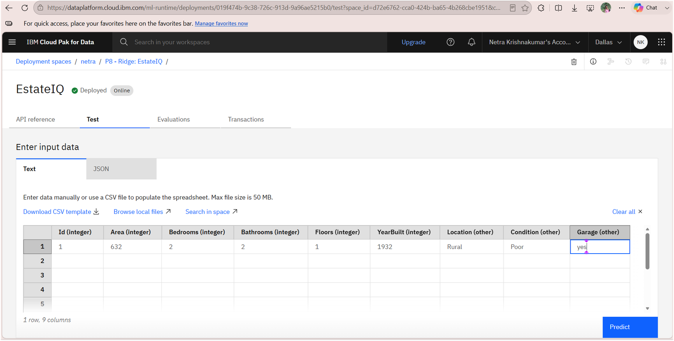
TRAINING SCREENSHOT

Slide 9
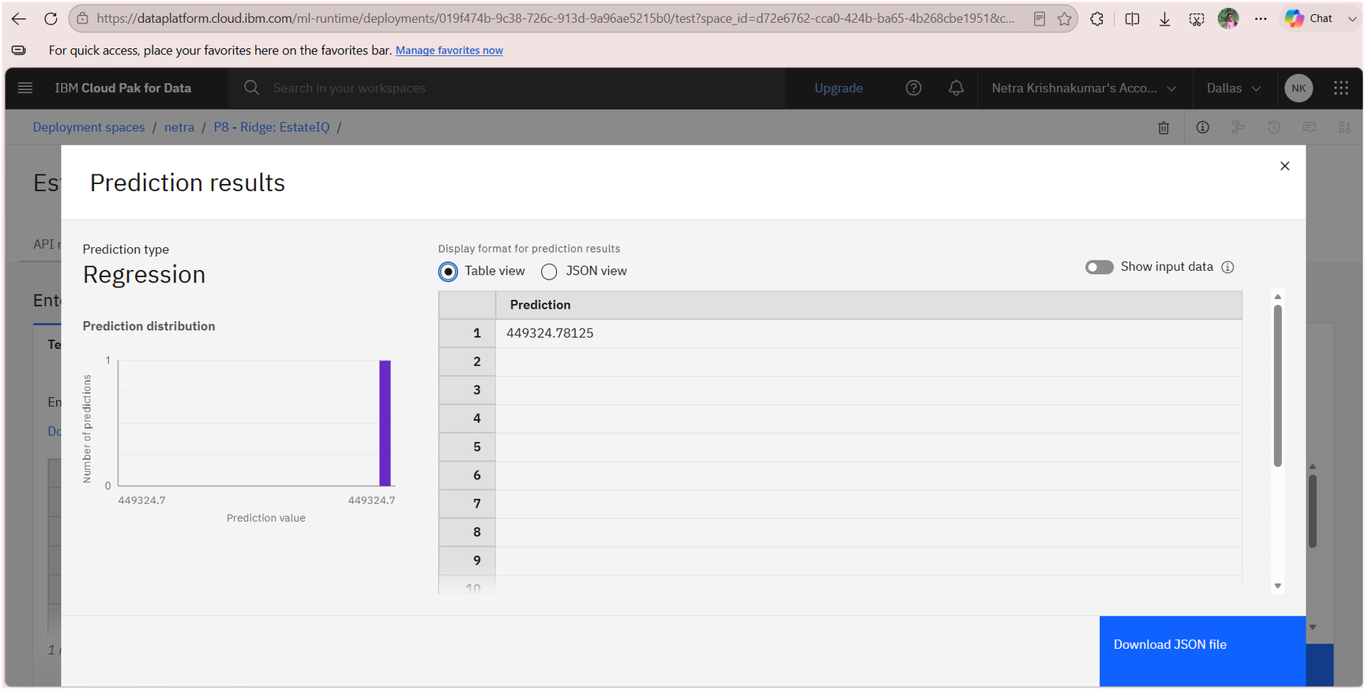
TRAINING SCREENSHOT

Slide 10
NOVELITY AND UNIQUENESS
EstateIQ transforms traditional property valuation into an AI-driven decision support system, enabling fast, transparent, and data-based house price estimation instead of relying on subjective market opinions.
Powered by IBM watsonx.ai AutoAI, the system automatically performs intelligent data preprocessing, feature engineering, algorithm selection, and hyperparameter optimization to identify the most suitable regression model with minimal manual effort.
Unlike conventional pricing methods, EstateIQ simultaneously evaluates multiple property attributes such as location, area, bedrooms, bathrooms, property condition, year built, floors, and garage availability to generate reliable market value predictions.
The integrated web application delivers real-time price predictions, making AI-powered property valuation accessible to home buyers, sellers, investors, and real estate professionals through a simple and user-friendly interface.
By promoting fair and transparent property pricing, EstateIQ reduces pricing bias, minimizes valuation inconsistencies, and empowers citizens to make informed financial decisions, contributing to a more trustworthy and efficient real estate ecosystem.
"EstateIQ bridges the gap between Artificial Intelligence and real estate by making intelligent property valuation accessible to everyone, supporting smarter investments and a more transparent housing market.”

Slide 11
GIT HUB LINK
Git hub link:https://github.com/Netrakrishnakumar/EstateIQ.git
Project deployment url:https://estateiq-8j0n.onrender.com/

Slide 12
FUTURE SCOPE:
Integrate real-time market data from real estate platforms to provide dynamic and up-to-date property price predictions.
Expand the prediction model by including additional factors such as nearby schools, hospitals, public transport, crime rate, pollution levels, and local amenities for more accurate valuation.
Develop an interactive map-based interface using GIS to visualize property prices across different locations and neighborhoods.
Incorporate market trend analysis to forecast future property prices, helping buyers and investors make long-term investment decisions.
Build a mobile application to provide instant property valuation and AI-powered recommendations anytime and anywhere.
Implement personalized property recommendations based on user preferences, budget, location, and lifestyle requirements.
Enable continuous model learning by automatically retraining the AI model with newly available property data to improve prediction accuracy over time.
Deploy the system at a larger scale to support real estate agencies, financial institutions, government housing departments, and property investors with intelligent, data-driven decision-making.

Slide 13
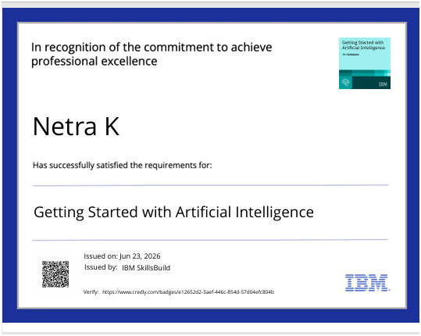
CERTIFCATE EARNED

Slide 14
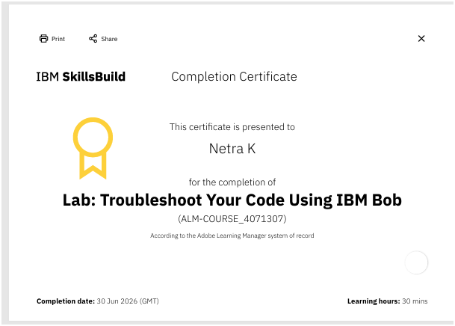
BOB CERTIFICATE

Slide 15
THANK YOU
“FOR YOUR INTREST AND TIME”

